Slide 1
LAB 8
BLE Bluetooth Communications and Multi-tasking in Arduino

Slide 2
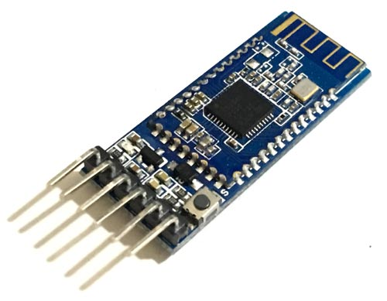
What is HM10 BLE 4.0 Module?
Is a serial BLE module (Bluetooth-Low-Energy) which is intended to use for the low power consumption application.
Can last long even with a coin-sized battery.
Based on the Texas Instruments CC2540 or CC2541 BLE System SoC (System on Chip)
The firmware and design of the module is made and managed by Jinan Huamao Technology.
The module comes with serial/UART layer which makes the device to be able to interface with different microcontroller.
become a very popular Bluetooth 4.0 BLE module

Slide 3
What is HM10 BLE 4.0 Module?
a data rate of up to 24 Mbps with low-energy/low-power consumption.
a distance range of 100 meters in open space.
Supports micro-airsync commumication, iOS and Android app communication, mast-slave modes and IO control

Slide 4
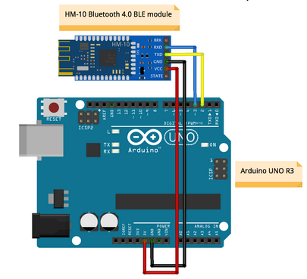
BLEBT HM-10 and Arduino Uno
Hardware Components
Arduino UNO
HM-10 Bluetooth Module
Resistors(1 ~ 10 kΩ)
Variable Resistor (1 ~ 10 kΩ)
LED
Jumper Wires
Mobile Phone

Slide 5
Checking HM-10 BLE BT
Connect the BT and the Arduino
Connect the Arduino’s USB cable to your computer
Download the sketch program named “BLEHM_Setting.ino” from Canvas

Slide 6
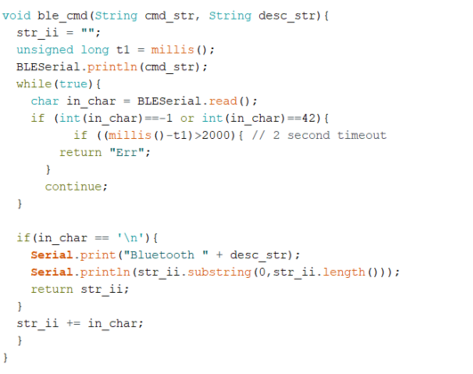
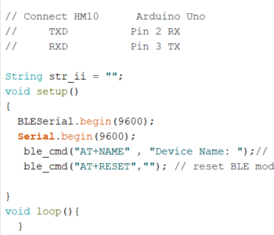
BLEHM_Setting

Slide 7
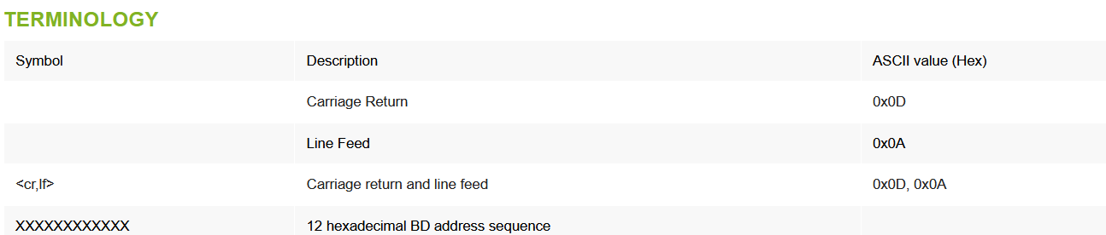
Bluetooth Setup and Configuration
The AT command set was developed by Hayes to control the operation of telephony modems.
The command set has been extended to control bluetooth device primary operation such as inquiry, connection setup/ disconnection etc.
The Bluetooth device powers up in unconnected state and can be configured using UART interface
https://wiki.lm-technologies.com/at-command-reference/

Slide 8
Command Response
<cr,lf>OK<cr,lf> – If the command has been sent to Bluetooth device in correct format and is applicable in current device operating mode.
<cr,lf>ERROR<cr,lf> – If the command has been sent in wrong format/command is invalid/ command is not applicable in current device operating mode.
<cr,lf> – If the command response has been disabled.
Open MLT-BT05-AT-commands (pdf) file from Canvas

Slide 9
Checking/Setting other parameters
Check
Name
Local Address MAC
Version
Baud rate
Role
Reset
Change name
Try to change other parameters

Slide 10
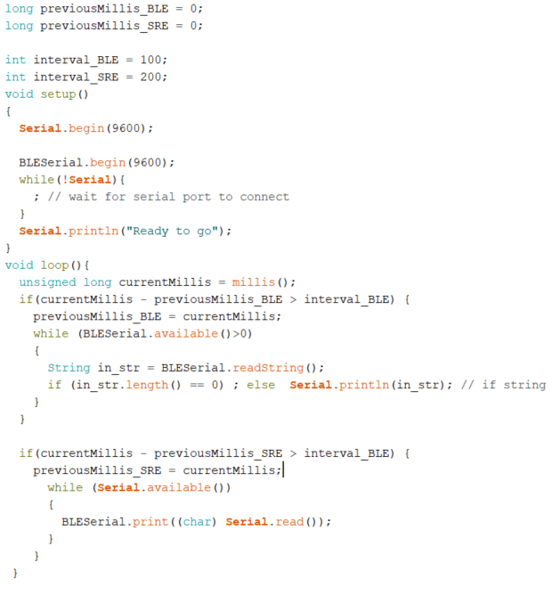
Communication with Mobile Phone
Create a new sketch and write the code on right-side
Open BLEscanner app in your mobile phone
Test

Slide 11
Assignment
Modify the program given to do the following tasks.
Read the message from the master device through BLE Bluetooth and display it on the Serial monitor.
Send the message from the Serial monitor to the Mobile phone.
If the received message is a special message such as “read” from phone, read the analog input which is connected to a potentiometer, and send its value to the Bluetooth every 3 seconds.
If the received message is another special message such as “stop”, stop sending the value.
Demonstrate your work to TAs.

Slide 12
Create a program (sketch) for on Arduino to do the following tasks
Blink LED 1 every second.
Read user input from ultrasonic sensor hc-sr04 and write the data to Serial Monitor if a push button (similar to tutorial) is pressed.
Power on LED 2 every 2 second.
Power on LED 3 if the potentiometer value is greater than 512.
Draw the block diagram of system and submit through Canvas.
Construct the system circuit using the required sensors and other electrical components.
Show your circuit when running your program to ATs.
Submit your program and the photo of your circuit through Canvas.

